Slide 1


QM Foundations Animations
Dr. Dustin Lazarovici
Humanities & Arts

Slide 2
Stern-Gerlach Experiment (Spin Measurements)

Slide 3

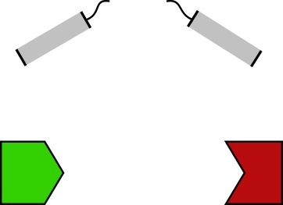

In an inhomogeneous magnetic field, the wave function splits along the spin components
$$\left({α \atop 0}\right)φ^{↑}\left(t, q\right)$$
Initial wave function
$$ψ= \left({α \atop β}\right)φ(q)$$
$$B_{z}$$
$$\left({0 \atop β}\right)φ^{↓}\left(t, q\right)$$

Slide 4
What is the probability of finding the particle above/below the symmetry axis?
$$P\left(Z\left(t\right)>0\right)$$
$$\left({α \atop 0}\right)φ^{↑}\left(q\right)$$
$$=\int_{z>0 }{{\left|α\right|}^{2}{\left|φ^{↑}\left(q\right)\right|}^{2}+{\left|β\right|}^{2}{\left|φ^{↓}\left(q\right)\right|}^{2} d^{3}q}$$
$$≈{\left|α\right|}^{2}$$
$$B_{z}$$
$$P\left(Z\left(t\right)<0\right)$$
$$=\int_{z<0 }{{\left|α\right|}^{2}{\left|φ^{↑}\left(q\right)\right|}^{2}+{\left|β\right|}^{2}{\left|φ^{↓}\left(q\right)\right|}^{2} d^{3}q}$$
$$\left({0 \atop β}\right)φ^{↓}\left(q\right)$$
$$≈{\left|β\right|}^{2}$$

Slide 5
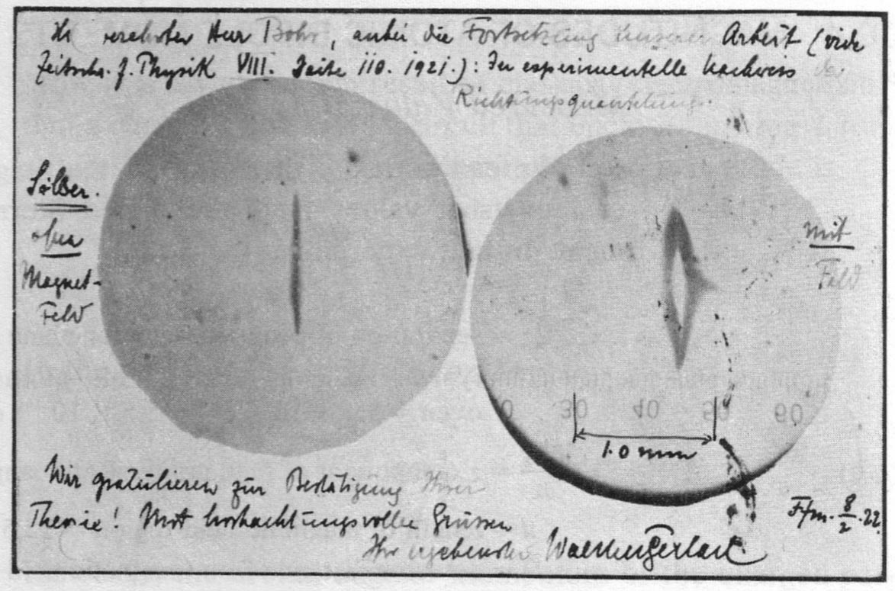

Slide 6

Animation: Stefan Teufel

Slide 7
X(t)
Animation: Stefan Teufel

Slide 8
X(t)
Animation: Stefan Teufel

Slide 9
The Measurement Problem (Schrödinger‘s Cat)

Slide 10


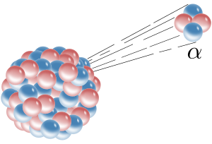
$$y$$
$$x$$

Slide 11
Many-Worlds
$$y$$
$$x$$

Slide 12
Bohmian Mechanics
$$y$$
$$Q=\left(X,Y\right)$$
$$x$$

Slide 13
Bohmian Mechanics
$$y$$
$$x$$

Slide 14
Objective Collapse Theories
$$y$$
$$x$$

Slide 15
Objective Collapse Theories
$$y$$
$$x$$

Slide 16
Decoherence and effective Collapse

Slide 17




The wave function of a single particle can easily interfere
$$ψ(x)$$
$$ℝ$$

Slide 18


The wave function of a single particle can easily interfere
$$ψ(x)$$
$$ℝ$$

Slide 19




The wave function of a single particle can easily interfere
$$ψ(x)$$
$$ℝ$$

Slide 20



If the particle interacts with a measurement device, we have to consider their common wave function on configuration space.
$$y$$
$$Ψ(x,y)$$
$$x$$

Slide 21



$$ℝ^{3n}$$
$$y$$
$$Ψ(x,y)$$
$$x$$
$$ℝ^{3}$$

Slide 22

$$ℝ^{3n}$$
$$y$$
$$Ψ(x,y)$$
$$x$$
$$ℝ^{3}$$

Slide 23

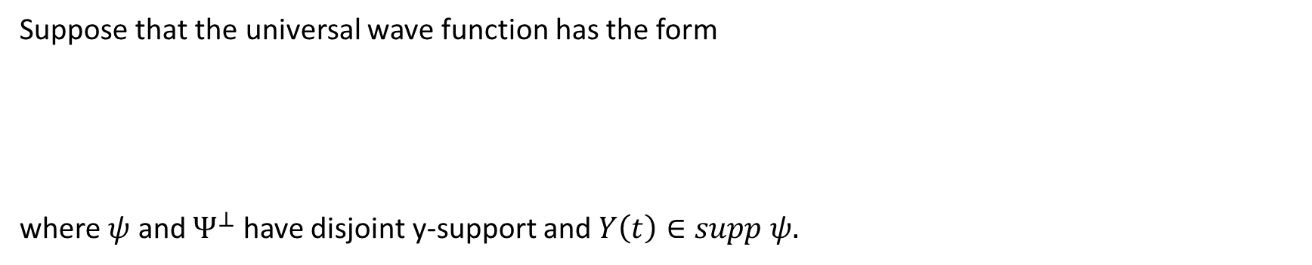
Effective Collapse in BM
Suppose that the universal wave function has the form
where $ψ$ and $Ψ^{⊥}$ have disjoint y-support and $Y\left(t\right)∈supp ψ.$
$Ψ\left(x, y\right)=φ\left(x\right)ψ\left(y\right)+Ψ^{⊥}(x,y)$
Then the conditional wave function becomes an effective wave function
$Φ_{t}^{Y}\left(x\right) ≔Ψ_{t}\left(x, Y\left(t\right)\right)= φ_{t}\left(x\right)ψ_{t}\left(Y(t)\right)+Ψ_{t}^{⊥}(x,Y(t))$
Or, after normalization
$$Φ_{t}^{Y}\left(x\right) ≔φ_{t}\left(x\right)$$

Slide 24
E.g. after spin measurement
$${(φ}_{1}+φ_{2})ψ_{0}→ φ_{1}ψ_{1}+φ_{2}ψ_{2}$$
If $Y\left(t\right)∈supp ψ_{1}$, the effective wave function collapses to $φ_{1}$
If $Y\left(t\right)∈supp ψ_{2}$, the effective wave function collapses to $φ_{2}$

Slide 25






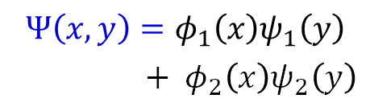


Collapse in Bohmian Mechanics
$$y$$
Wave function of system + apparatus:
$$Ψ\left(x,y\right)=φ_{1}\left(x\right)ψ_{1}\left(y\right)$$
$+{ φ}_{2}\left(x\right)ψ_{2}\left(y\right)$
$$x$$
Wave function of subsystem:
$φ(t)=Ψ(x, Y(t))$
Animation: Stefan Teufel

Slide 26
Collapse in Bohmian Mechanics
$$y$$
Wave function of system + apparatus:
$$Ψ\left(x,y\right)=φ_{1}\left(x\right)ψ_{1}\left(y\right)$$
$+{ φ}_{2}\left(x\right)ψ_{2}\left(y\right)$
$$x$$
Wave function of subsystem:
$φ(t)=Ψ(x, Y(t))$
Animation: Stefan Teufel

Slide 27
Probability and the Born Rule
(not an animation but could be turned into a simulation)

Slide 28
The Galton Board
Is the system deterministic or indeterministic?
What about the system is predictable/unpredictable?
What statistical phenomenon do you observe?
How do you explain the statistical phenomenon?
Where (if at all) did you invoke the concept of probability?

Slide 29
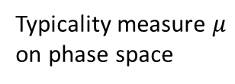
Typicality measure $μ$
on phase space

Slide 30
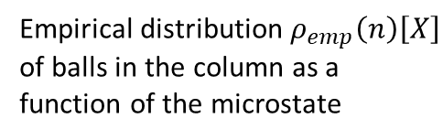

$$X$$
Empirical distribution $ρ_{emp}\left(n\right)\left[X\right]$
of balls in the column as a function of the microstate

Slide 31
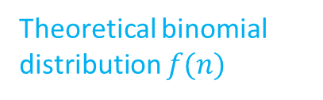
Theoretical binomial distribution $f(n)$

Slide 32


Typicality result:
$$μ$$
$$μ\left(X :\left|ρ_{emp}\left(n\right)\left[X\right]−f\left(n\right)\right|<ε ∀n\right)≈1$$
Probabilities are typical relative frequencies
$$f(n)$$
$$ρ_{emp}\left(n\right)\left[X\right]$$

Slide 33
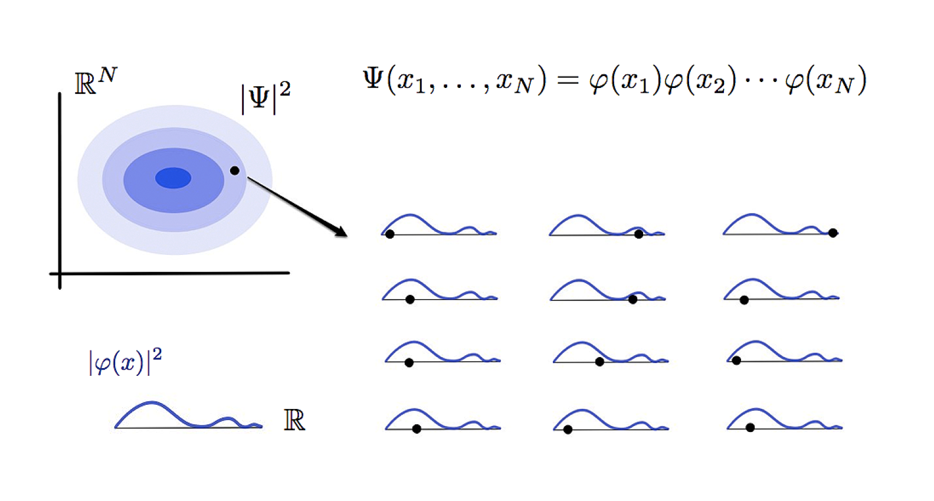
Quantum equilibrium distribution in an ensemble of identically prepared subsystems:

Slide 34
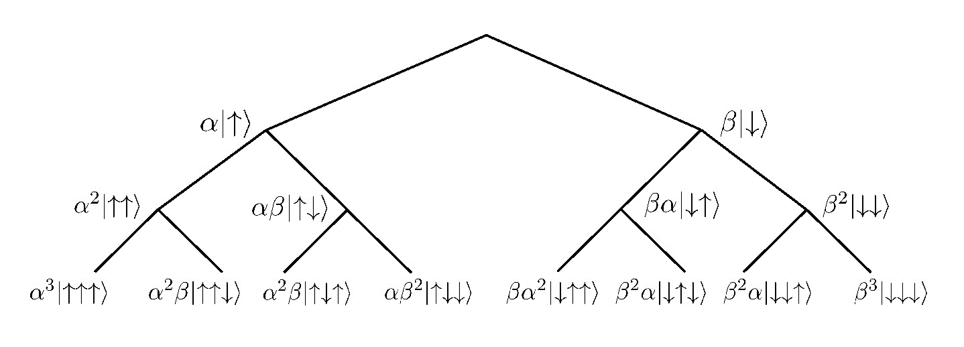
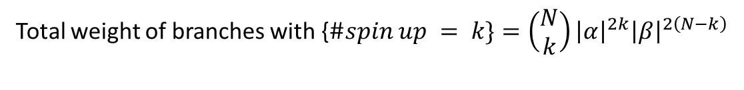
Everett‘s Typicality Account in Many-Worlds
$$\text{Branching} \text{Many}\text{−}\text{Worlds} \text{histories} \text{after} \text{three} \text{spin} \text{measurements}\text{.} \text{Adapted} \text{from} \text{Barrett}\text{ (2016).}$$
Total weight of branches with {$\#spin up = k\}=\left(\begin{matrix}N \\ k\end{matrix}\right){\left|α\right|}^{2k}{\left|β\right|}^{2\left(N−k\right)}$
Total weight of branches with $\left\{\#spin up≈{\left|α\right|}^{2}\right\}≈1$(for large $N$)
In nearly all branches, spin up is registered with a frequency approximating the Born probability ${\left|α\right|}^{2}$.

